Slide 1
Rainfall sensor Update
Keith Matthews

Slide 2
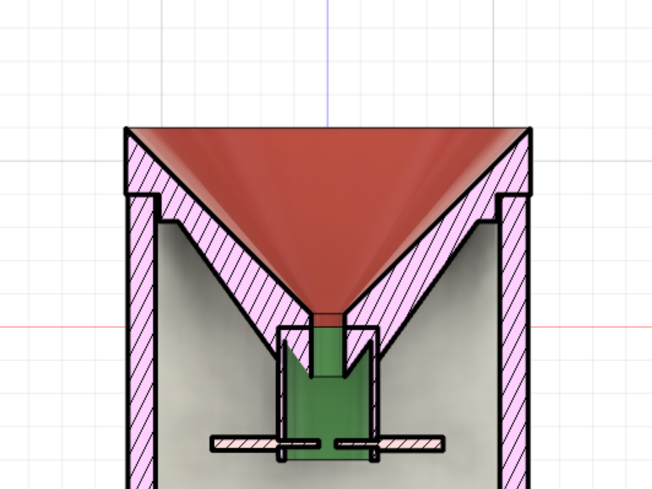
Design
Funnel
Funnel
Gathers water drops into central area
Nozzle
Reforms individual drops
Electrodes
Measure Water drops passing through
Nozzle
Electrodes

Slide 3
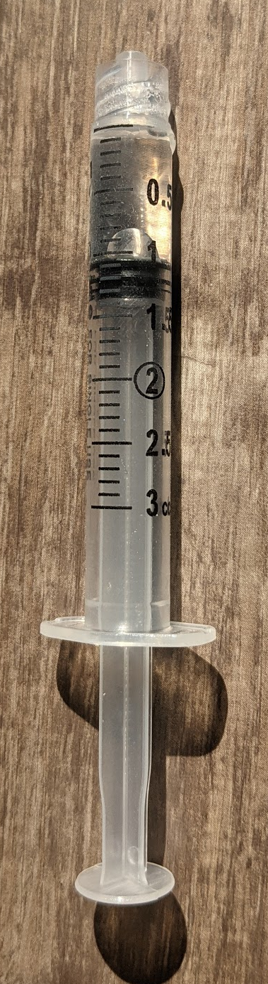
Design Condition
Max: Worlds greatest 1 hour rainfall
12” in 1 hour
For our system needs to process 1ml of water every 7.75 seconds
Designed to handle the max rainfall event

Slide 4
Thoughts, Question, or Advise?

